Slide 1
Condition monitoring and failure analysis of liquefied natural gas plant flow control valve stem packing system
E. Pereira, B.M Alkali & O. Niculita
Department of Engineering, School of Engineering and Built Environment, Glasgow Caledonian University, United Kingdom

Slide 2
Outline of Presentation
  Introduction
  System Description
  Stem Packing Failures
  FV Dynamic Response Test
  Test I (Flow variation) observation
  Vibration Test Points
  Root Cause Analysis
  Proposed V-ring packing re-design
  Conclusion

Slide 3
Introduction
The FV-flow control valve has experienced multiple packing leaks and failures while operating at increased gas flow rates.
Increased vibration was observed which is believed to be a contributing factor to the premature packing failures.
Notes:
During operation groove in the mating ring generates a fluid dynamic force causing the primary ring to separate from the mating ring, creating a running gap between the two rings.

Slide 4
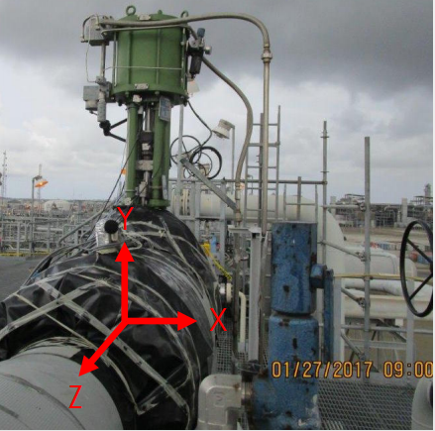
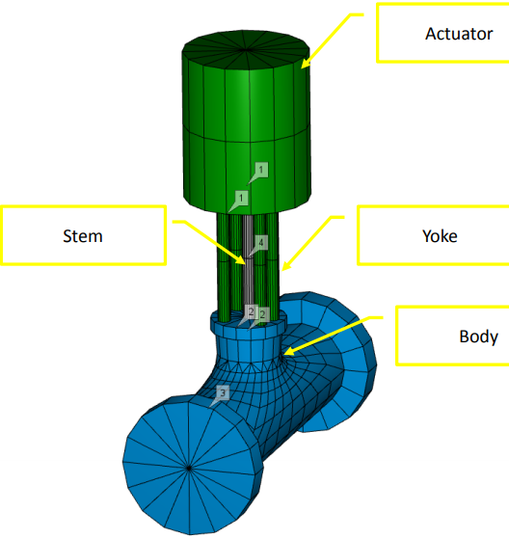
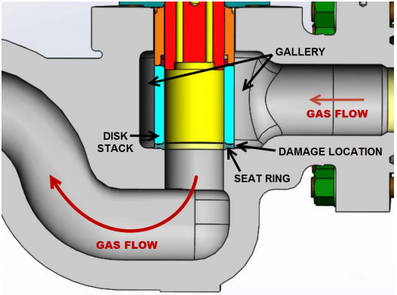
System Description
FV is a flow control drag valve which controls feed gas from Block A/B and C. Gas from offshore flows through a series of valves and a gas heater prior to tying into the feed gas header.

Slide 5
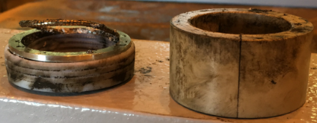
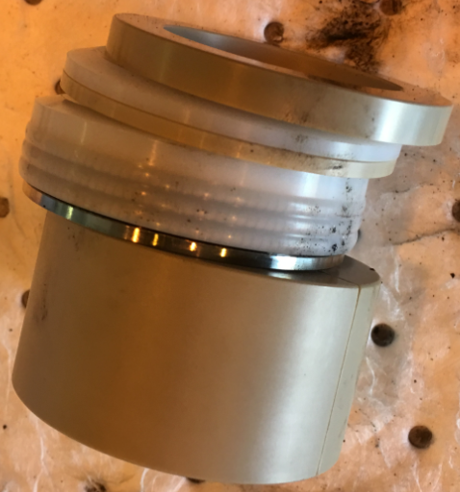
  Stem Packing Failures
The stem packing failures described occurred primary on the backside (downstream end) of the stem.

Slide 6
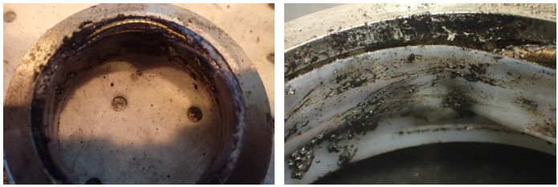
  Stem Packing Failures
  Reliability issues have previously classified this system as a bad actor with a rate of 3 to 4 corrective maintenance work orders per month.

Slide 7
  FV Dynamic Response Test
  The dynamic response of FV was monitored during the following testing:
  Test I – The flow through FV was gradually increased from 13 mmscfh to 20 mmscfh. Inlet/outlet pressures and gas temperature were held relatively constant.

Slide 8
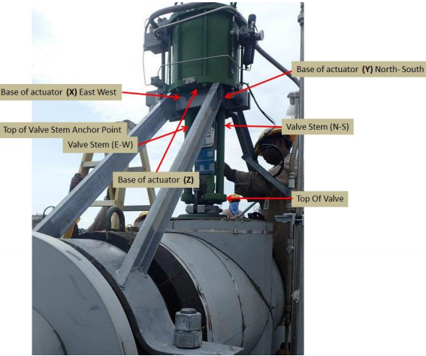
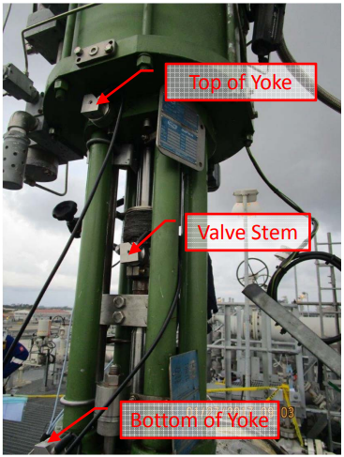
  Vibration Test Points

Slide 9
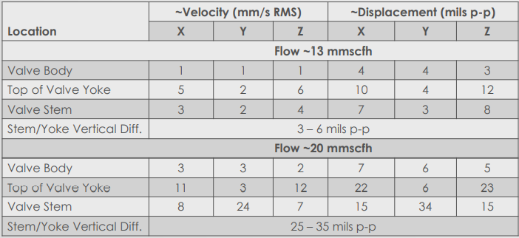
  Test I (Flow variation) observation
  The following amplitudes were measured at ~13 and 20 mmscfh:

Slide 10
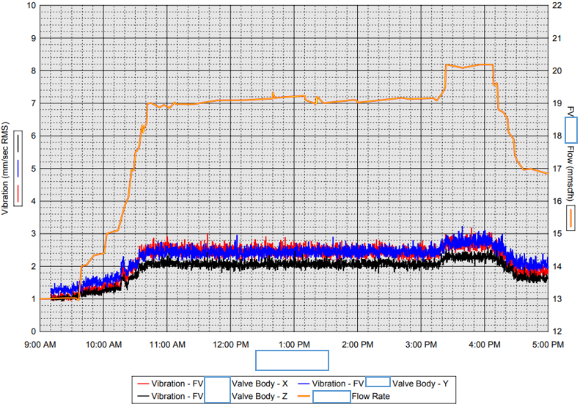
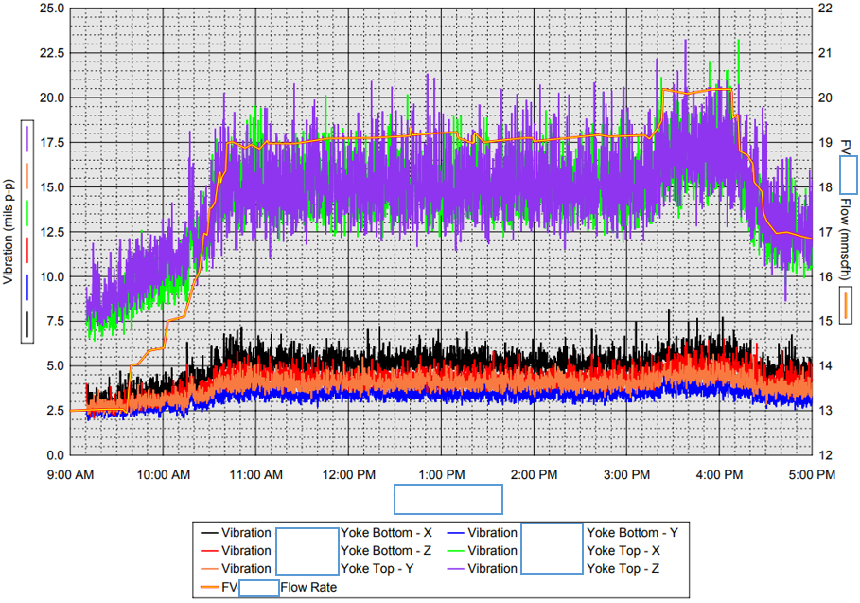
  Test I (Flow variation) observation

Slide 11
  Root Cause Analysis
  Root cause analysis of the stem packing failure is conducted and are believed to be:
  • Vibration studies indicate piping design as the ‘likely’ root cause, creating high flow turbulence and vibration at the valve inlet.
  • Valve design is creating pressure pulsations in the outlet piping causing vibration.
  • Vibrations in the system is due to flow through the multiple bends comprising the bottom of the valve body. This causes velocity transients (flow fluctuations) around sharp corners inside the valve and at the expander.

Slide 12
  Proposed V-ring packing re-design
  The current (FV) valves are experiencing packing leaks and trash buildup in the packing area. To protect the stem against trash buildup and provide a level of safety against vibration the packing configuration will be re-designed per the layout below.
  The re-designed packing configuration includes the following:
  • Wiper Rings – Wiper rings have been added to the top and bottom of the area to increase prevention against trash buildup.
  • Stem Guides – Re-designed stem guides with tight tolerances have been added for lateral stem support. This provides a more robust arrangement for vibration resistance.

Slide 13
  Proposed V-ring packing re-design
  V-Ring Packing – Multi-contact packing design with 8 points of contact with the stem compared to 3 in the current design.

Slide 14
  Conclusion
  At increased flow rates, the valve stem sporadically vibrates vertically relative to the valve body, yoke through the packing. This behaviour gets progressively worse as the rates increase. Approximately 3-6 mils peak-peak(1 mil = 0.001 inches) of oscillation occurred at 13 mmscfh and increased to 25-35 mils peak-peak as the flow rate reached approximately 20 mmscfh. It is believed that this amount of vertical oscillation is prematurely wearing out the packing at the higher flow rates.

Slide 15
Thank You
Questions?

